Slide 1
Task 3.1 State-of-the-Art, Threat model and Technical Specifications
Public Threat Reports Exploration
WP3 Second Meeting
20 Dec 2024
ICCS

Slide 2
Outline
Overview
MITRE ATLAS
ENISA THREAT LANDSCAPE 2024
ENISA AI CYBERSECURITY CHALLENGES 2020
-

Slide 3
Overview
MITRE Adversarial Threat Landscape for AI Systems (ATLAS™) is a globally accessible, living knowledge base of adversary tactics and techniques.
European Union Agency for Cybersecurity (ENISA) is the Union’s agency dedicated to achieving a high common level of cybersecurity across Europe.
ENISA Threat Landscape 2024
ENISA AI Cybersecurity Challenges 2020

Slide 4
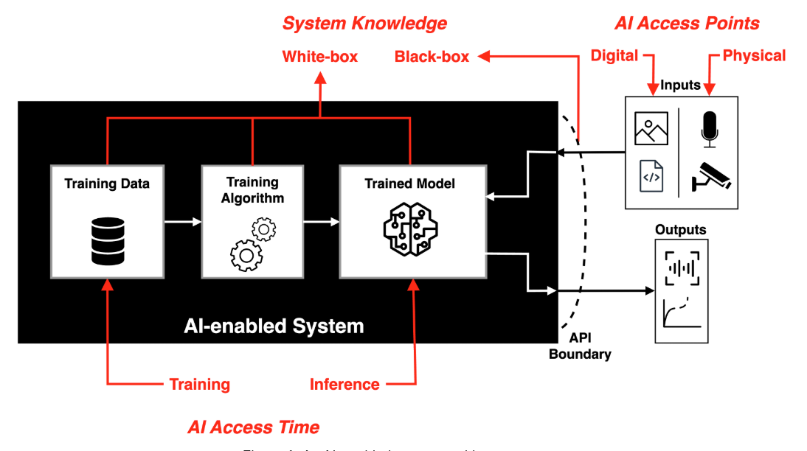
MITRE ATLAS - Path of Attack
Three important concepts that dictate an adversary’s path of Attack:
AI Access Time (Training, Inference)
AI Access Points (Digital, Physical)
System Knowledge (White-box, Black-box, Grey-box)

Slide 5
MITRE ATLAS - Tactics
Tactics are the tactical adversary’s goals during an attack.
Reconnaissance: Adversaries gathering information to support targeting.
Resource Development: Adversaries gathering resources to support targeting.
Initial Access: Techniques that adversaries use to gain initial access to the machine learning system.
ML Model Access: Access that adversaries have ranging from full to none.
Execution: Running malicious code on a target system.
Persistence: Maintaining access to systems; often involve leaving behind modified ML artifacts (e.g. poisoned training data, backdoored ML models).
Privilege Escalation: Gaining higher-level permissions to execute more impactful attacks.
Defense Evasion: Avoiding detection by machine learning-enabled security software.
Credential Access: Stealing credentials.
Discovery: Techniques used by adversaries to gain knowledge about the machine learning environment.
Collection: Gathering sensitive data or information of interest.
ML Attack Staging: Preparation of the attack on the target ML model based on knowledge and access.
Exfiltration: Stealing data from the ML model.
Impact: Disrupting availability or compromising integrity (e.g. destroying/tampering data).

Slide 6
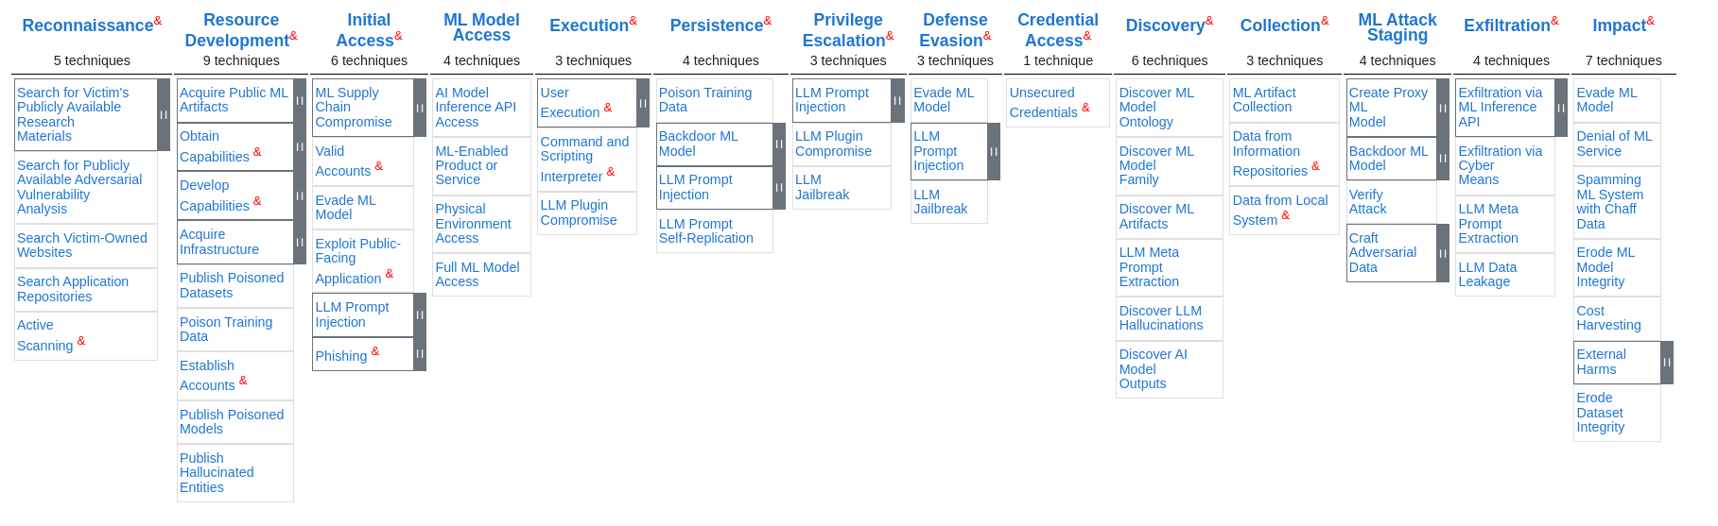
MITRE ATLAS - Techniques
Techniques are the means by which adversaries achieve tactical goals or represent “what” an adversary gains by performing an action.

Slide 7
MITRE ATLAS - Techniques
Threat | Summary | Mitigations
Training Data Poisoning | Adversarial modification of the data or its labels. | Training Data Sanitization, AI Bill of Materials.
ML Supply Chain Compromise | Compromises in unique portions of the ML supply chain (e.g hardware, data, parts of ML stack, model) that may provide initial access to a system. | Verify ML artifacts,
Evade ML Model Detection | Adversaries can craft adversarial data that prevent a machine learning model from correctly identifying/detecting the contents of the data. | Model Hardening (e.g. adversarial training network distillation), Use Ensemble Methods, Input Detection and Restoration, Use Multi-Modal Sensors
AI Model Inference API Access | Adversaries may gain access to a model from the inference API and gather information, prepare attacks, or directly affect the system. Attackers can recover a functionally equivalent model by iteratively querying the model | Control Access to ML Models (e.g. authentication for API endpoints), Restrict Number of ML Model Queries
Full ML Model Access | Adversaries may gain full white-box access to a machine learning model. | Model Distribution Methods
Backdoor ML Model | Adversaries may introduce a backdoor into a ML model. The model will produce the adversary’s desired output when a trigger is introduced to the input data. | Training Data Sanitization, ML Model Validation
Craft Adversarial Data | Adversarial data are inputs intentionally modified to manipulate a machine learning model, causing it to produce the adversary's desired outcome, such as misclassifying an image or missing a detection. White-Box Optimization Black-Box Optimization & Transfer | Model Distribution Methods (for White-Box), Restrict Number of ML Model Queries (for Black-Box), Input Restoration
Denial of ML Service | Adversaries may target ML systems with a flood of requests for the purpose of degrading or shutting down the service | Restrict Number of ML Model Queries, Adversarial Input Detection

Slide 8
ENISA
ENISA THREAT LANDSCAPE 2024
Threats against Data:
Data Breach
Data Leak
Data Manipulation - Data Poisoning
Threats against Availability:
Denial of Service

Slide 9
ENISA
ENISA AI CYBERSECURITY CHALLENGES 2020
Threat | Description | Potential Impact | Affected Assets
Adversarial Examples | Targeting the inference phase to affect model performance and effectiveness. | Integrity, Availability | Model, Data
Backdoor / Insert Attacks (Training) | Introducing trigger patterns in training data to cause misclassifications at Inference. | Integrity | Data
Data Manipulation (Training) | Bias in data, label manipulation, and inserting poisoned data in augmented sets. | Integrity | Data
Algorithm Compromise | Targeting ML algorithms to degrade accuracy or availability. | Integrity, Availability | Model
Augmented Data Issues | Noise or irrelevant patterns in automatically generated datasets. | Integrity | Data
Compromised Data Providers | Manipulation of data by brokers/providers (e.g., poisoning, deletion). | Integrity, Availability | Actor
Framework Misconfigurations | Vulnerabilities due to complex model frameworks. | Integrity, Availability | Artifacts, Environment/Tools
Data Poisoning | Tampered data injected into training/validation sets. | Availability, Integrity | Process, Environment/Tools, Model
Data Tampering | Manipulation by actors (e.g AI engineers) during storage or processes like feature selection. | Availability, Integrity | Process, Environment/Tools, Model
Distributed DoS Attacks | Availability disruption of online IT Systems used to support AI systems (e.g. cloud storage) | Availability | Environment/Tools
Elevation-of-Privilege | Exploiting trained models to gain access to parameters used or dataset details (e.g. MI) | Confidentiality, Availability | Model, Data
Insider Threats | Deliberate exposure of sensitive data or models. | Confidentiality, Integrity | Actors
Selection Bias | Purposeful introduction of bias in raw datasets. | Integrity, Availability | Data
Label Manipulation | Modifying or weakening training labels. | Availability, Integrity | Processes, Data
Data Transfer/Storage Manipulation | Tampering during data transfer or in third-party storage. | Confidentiality, Integrity | Environment/Tools
Hyper-parameter Manipulation | Adversaries influencing behavior through parameter tuning. | Integrity, Availability | Process, Model
Optimization Algorithm Abuse | Erroneous model tuning through malicious algorithm use. | Availability | Model
Model Confidentiality Exploits | Leaking internal parameters or sensitive model information. | Confidentiality | Model
Model Backdoors | Hidden vulnerabilities or malicious code in models during development. | Integrity, Availability, Confidentiality | Process
Adversarial Attack Transferability | Adversarial examples applied across applications. | Integrity | Process, Environment/Tools

